Slide 1
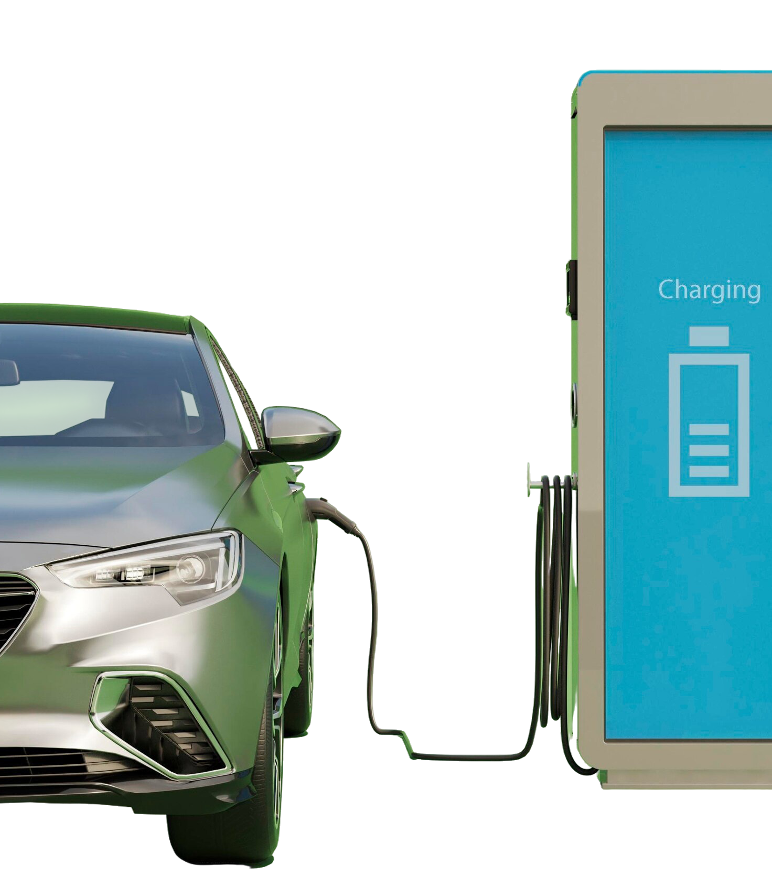
The Scale & Impact of the Shift to EVs Among Malaysian Drivers
Forward College Professional Certificate in Data Analytics
Tee Le Peng
Notes:
Good evening, today I’m going to present my capstone project looking at the scale & impact of the shift to electric vehicles (EVs) among Malaysian drivers.
The Malaysian automobile market has been undergoing rapid transformation, especially now we are seeing a lot more EVs on the road compared to a few years ago. Yet, the actual scale and impact of such a change has not been clear. Therefore, this project seeks to understand the magnitude of the shift to EVs in the Malaysian automobile market and how each player in the market has fared.

Slide 2
Introduction
Literature Review
Agenda
Project Objectives
Analysis
Discussion
Conclusion

Slide 3

Introduction
EVs are entering the mainstream in Malaysia thanks to government initiatives and affordable Chinese EV brands
To what extent the EV adoption has picked up its momentum?
How has it impacted the different players the MY automobile market?
What are consumers’ consideration points with regard to owning an EV?
Notes:
EV used to be a niche category until when Chinese-branded EVs, led by BYD and Chery entered the Malaysian market in late 2022. Since then, EV adoption has picked up. But to what extent has the adoption been, how has it impacted the different players in the market, and what consumers are thinking when it comes to buying an EV? These are the key questions guiding this project.

Slide 4

Literature Review
Challenges of EV adoption in Malaysia
High cost of an EV
High travel demand
Limited availability of charging stations
High impact on power grid
Limited battery capacity
Behavioural Factors Influencing EV Adoption
Level of trust in EVs
Personal norms (internal moral obligations)
Concern about the environment
Consumer Perceptions in Malaysia
Scepticism toward the value proposition of EV ownership
Risk aversion
Notes:
There have been a couple of studies done around this topic. Namely,
There are studies that identified the key challenges to EV adoption in Malaysia.
There have also been studies that identified behavioural factors influencing EV adoption.
A study aiming to find out the reasons Malaysia lag behind many developing countries in EV adoption listed negative consumer perceptions to be among the key reasons. The study done in 2022 found that the public was largely sceptical of the value that EVs bring and perceived switching to EV as a risk.

Slide 5
Project Objectives
EV Adoption Trends
Market Share Analysis
Consumer Sentiment
Price Comparison
How quickly are Malaysians adopting electric vehicles (EVs)?
Any specific car type preferred by EV owners?
What portion of the automobile market is captured by EVs?
How has the entry of Chinese EV brands affected the market shares of local and other foreign brands?
What are the underlying reasons or sentiments influencing a car owner’s decision to choose an EV?
Are there significant differences in the prices Malaysian car owners are paying for EVs versus a normal petrol-powered car?
Notes:
This project has four key objectives:
EV adoption trends: How quickly are Malaysians adopting EV? Any specific car type that EV owners prefer?
Market share analysis: What’s the percentage of the market captured by EVs? How have Chinese EV brands affected the market share of other EV players?
Consumer sentiment: What causes a driver to choose to buy an EV or not to buy an EV?
Price comparison: Is there any difference in the price point that car owners are paying for an EV car versus a petrol car?

Slide 6



Methodology
Data Preparation
Cleaning, transformation, and exploratory analysis
Key variables: Manufacturer, vehicle type, fuel type, and specific model
Quantitative Analysis
Annual trends, market share shifts, and adoption rates for EVs
Qualitative Analysis
Keyword analysis on Reddit threads
Sentiments, perceptions, concerns, and motivations related to EV ownership
The Scale & Impact of the Shift to EVs Among Malaysian Drivers
Notes:
I carried out this study through three steps:
Prepared the data by cleaning, transforming it and also performing exploratory analysis.
Did quantitative analysis: Drew up charts to find out annual trends, market share shifts, and adoption rates for EVs across the years
Did qualitative analysis: Used Wordcloud to do keyword analysis on Reddit threads to find out the sentiments, perceptions, concerns, and motivations related to EV ownership.

Slide 7

Analysis Market Share Trends

Slide 8
Total Vehicle Registrations
678,115
856,292
Total Registrations
2015
Total Registrations
2024
26.28%
Notes:
The total number of vehicle registrations in Malaysia increased by 26.28% across the study period — from 678,115 in 2015 to 856,292 in 2024.

Slide 9
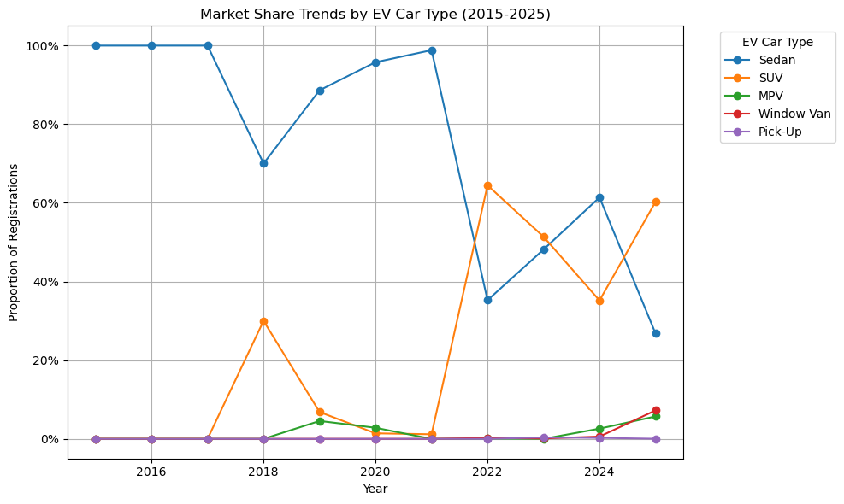
Market Share Trends by EV Car Type
Most popular:
Sedan & SUV
Notes:
Among EVs, sedans and SUVs remain the most popular choices. As of 2025, the market shows a clear shift towards SUVs, which account for 60.25% of EV registrations, compared to 26.81% for sedans.
Definition Sedan: Like Honda Civic, Myvi SUV: Like Honda CRV, Atto 3 MPV: Multi-purpose-vehicle, like Alza, Innova Pick-up: Like Hilux Window Van: Like Alphard, Vellfire, Serena

Slide 10
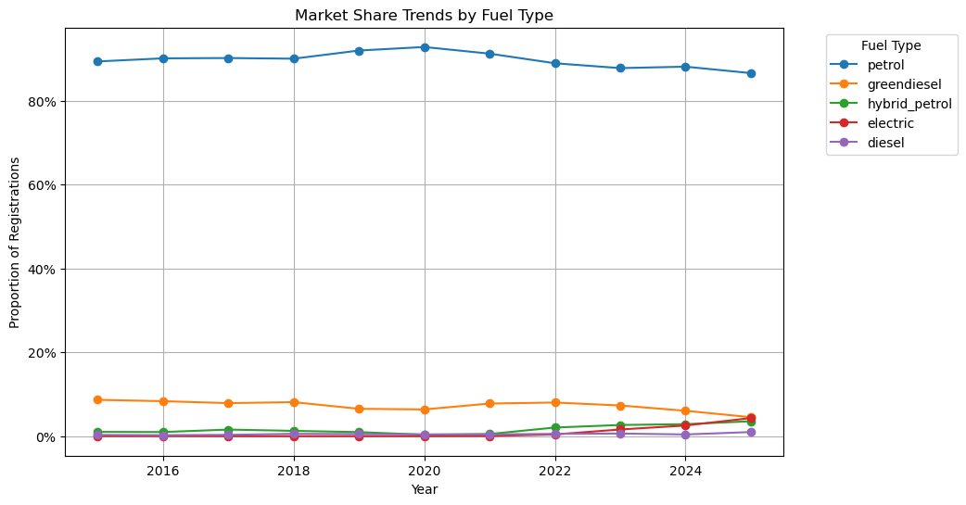
Market Share Trends by Fuel Type
Sharpest growth:
EV
Notes:
When viewed by fuel type, EVs have experienced the sharpest growth — rising from a negligible 0.01% market share in 2015 to 4.32% in 2025. Notably, this surge only began after 2020, as the market share remained below 0.01% between 2015 and 2020, before gaining momentum in early 2020.
Greendiesel: A second-generation biofuel produced by deoxygenation of renewable feedstocks like vegetable oils and waste cooking oil, which offers a lower-emission alternative to petroleum diesel with similar properties.

Slide 11
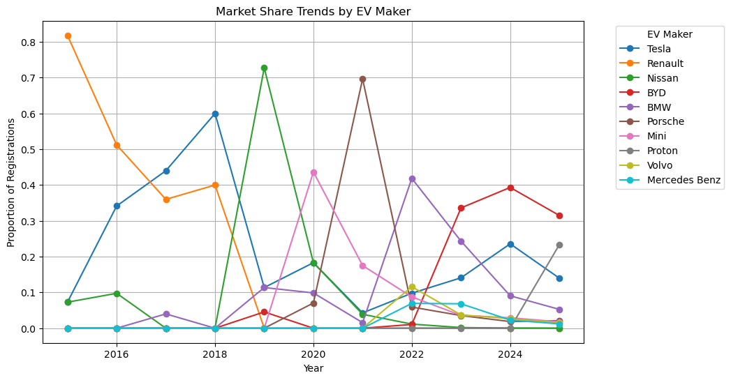
Market Share Trends by EV Maker
Most popular in 2025:
BYD & Proton
Notes:
The EV market has undergone significant shifts in brand dominance. In 2015, Renault held a commanding 81.82% share of Malaysia’s small EV market (just 45 units sold). However, by 2025, Renault had exited the EV market in Malaysia. Early leaders such as Nissan and Porsche also saw steep declines — Nissan’s share fell from 72.73% in 2019 to 0.02% in 2025, while Porsche’s dropped from 69.65% in 2021 to 2.09% in 2025. The EV market in 2025 is dominated by BYD and Proton, both of whom make up over half of the market share.

Slide 12
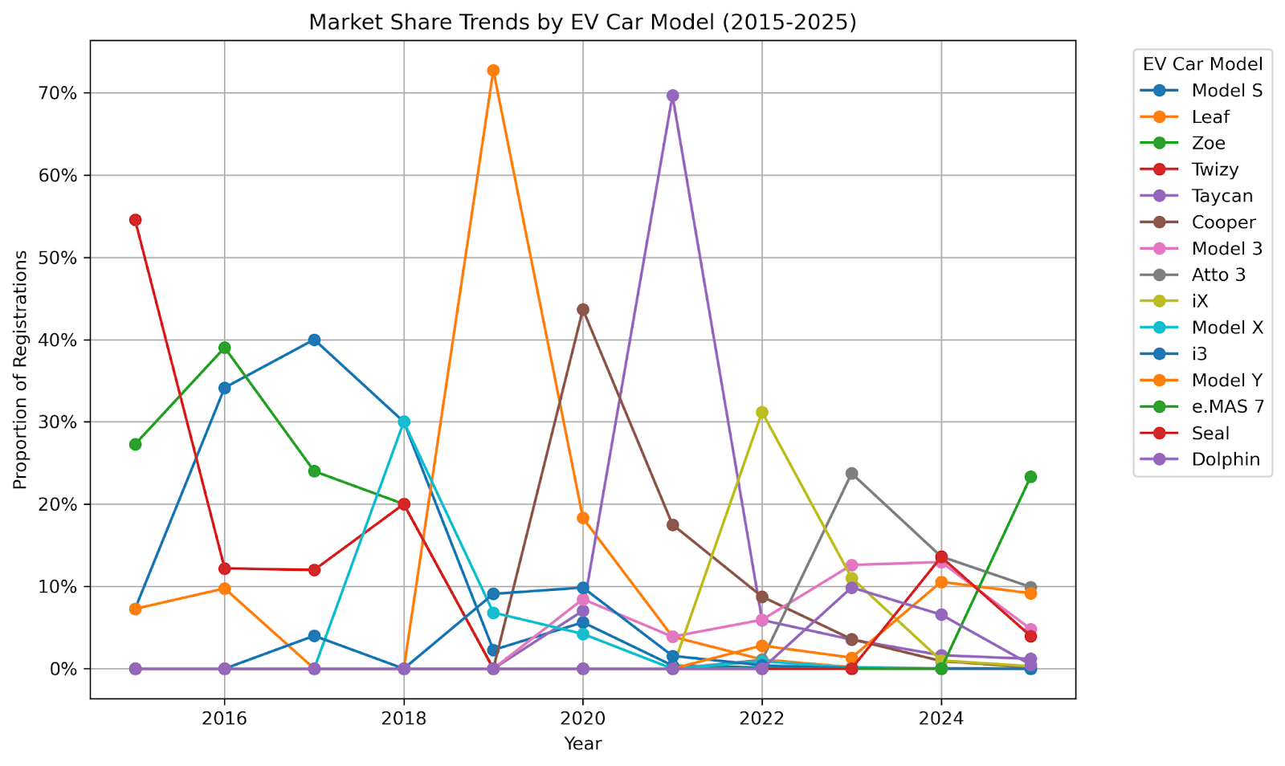
Market Share Trends by EV Car Model
Most popular in 2025:
Proton e.MAS 7
Notes:
In terms of individual models, the BYD Atto 3 led in sales volume from its Malaysian debut until December 2024. That changed with the launch of the Proton e.MAS 7, which quickly rose to become the best-selling EV in 2025, registering 4,003 units (23.35% of the market share). It is followed by the BYD Atto 3 (1,701 units, 9.92%) and the Tesla Model Y (1,571 units, 9.16%).

Slide 13
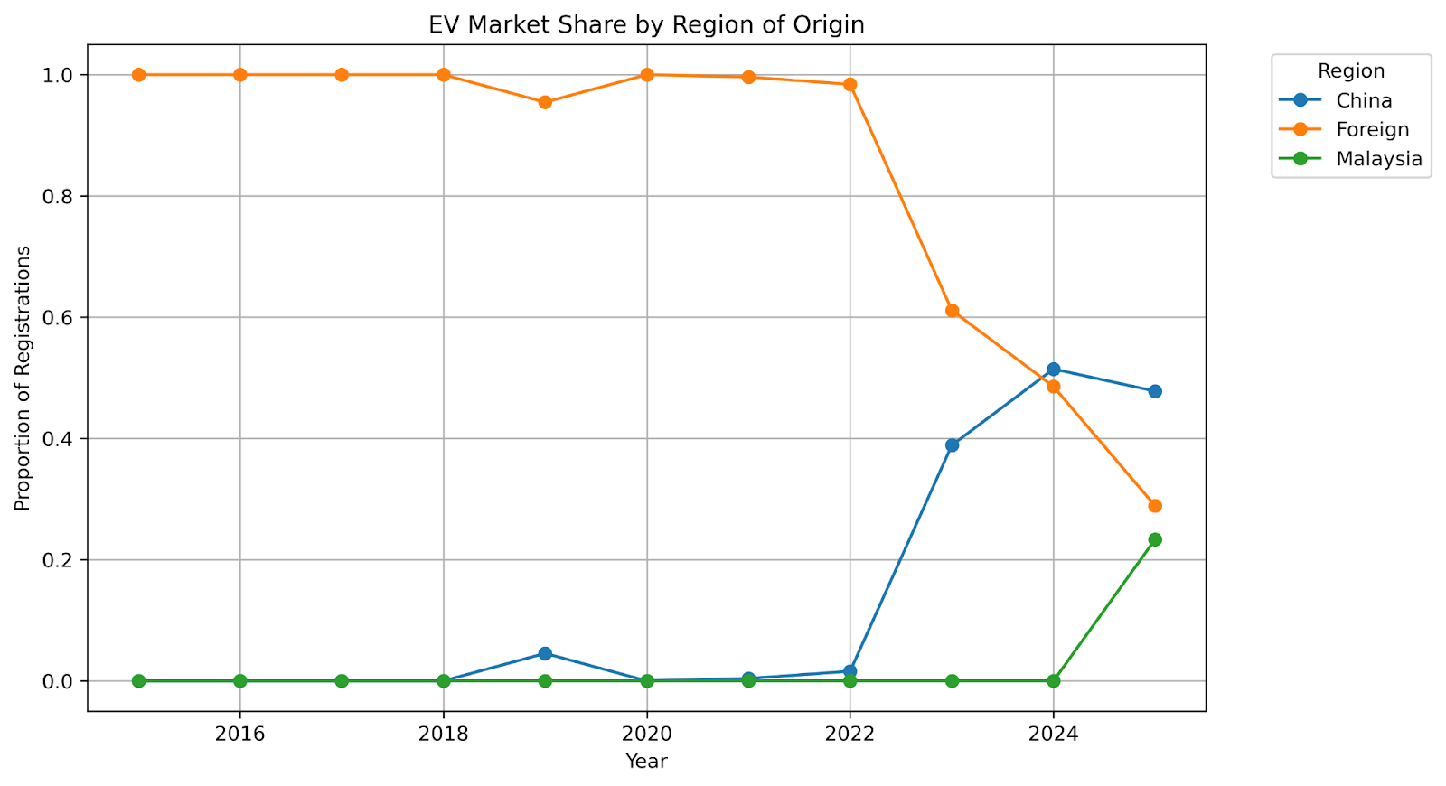
Market Share Trends by EV Makers’ Region of Origin
Most popular:
Chinese brands
Notes:
Foreign EV brands — including Tesla, Renault, and Nissan — were the early frontrunners in Malaysia’s emerging EV market. This landscape shifted dramatically in late 2022 with the arrival of Chinese brands such as BYD and Chery. By 2023, Chinese brands had overtaken their foreign counterparts.
Participation of local EV brands in the EV market gained momentum with the launch of the Proton eMAS 7 in December 2024. As Malaysia’s first domestically produced EV model, it made an immediate impact, selling 4,003 units within just six months of release — a performance that positioned it as a key player in the Malaysian EV market.

Slide 14
Median price Malaysian car owners pay for a petrol car
Top 10 Petrol Models (by total market share from 2015 to 2025) | Minimum On‑Road Price (RM) | Registration Count
Axia | 22,000 | 757707
Myvi | 46,500 | 711592
Bezza | 34,580 | 589423
Saga | 34,800 | 478611
City | 84,900 | 326352
Alza | 62,500 | 299650
Vios | 89,600 | 257144
Persona | 44,600 | 187412
HR-V | 115,900 | 170543
Ativa | 71,200 | 149273
Weighted median price:
RM 44,600
Notes:
To compare the price points of EVs and petrol cars, I calculated the weighted median price of the top 10 models in both categories.
Weighted median price among the top 10 petrol models: RM 44,600.00

Slide 15
Median price Malaysian car owners pay for an EV
Top 10 EV Models (by total market share from 2015 to 2025) | Minimum On‑Road Price (RM) | Registration Count
Atto 3 | 123,800 | 7860
Cooper | 193,888 | 6589
Model 3 | 189,000 | 5527
iX | 385,430 | 2711
Taycan | 575,000 | 1400
Leaf | 168,888 | 133
Model X | 238,000 | 64
Zoe | 165,000 | 53
Model S | 339,000 | 48
Twizy | 71,888 | 42
Weighted median price:
RM 189,000
Notes:
Weighted median price among top 10 EV models: RM 189,000.00.
- This comparison shows that, as of 2025, EVs are still priced primarily for the higher-income segment.

Slide 16
Analysis Malaysian car owners’ sentiment on EV purchase decision
Notes:
To understand what Malaysians consider when buying an EV, I reviewed four Reddit threads discussing EV purchases.

Slide 17
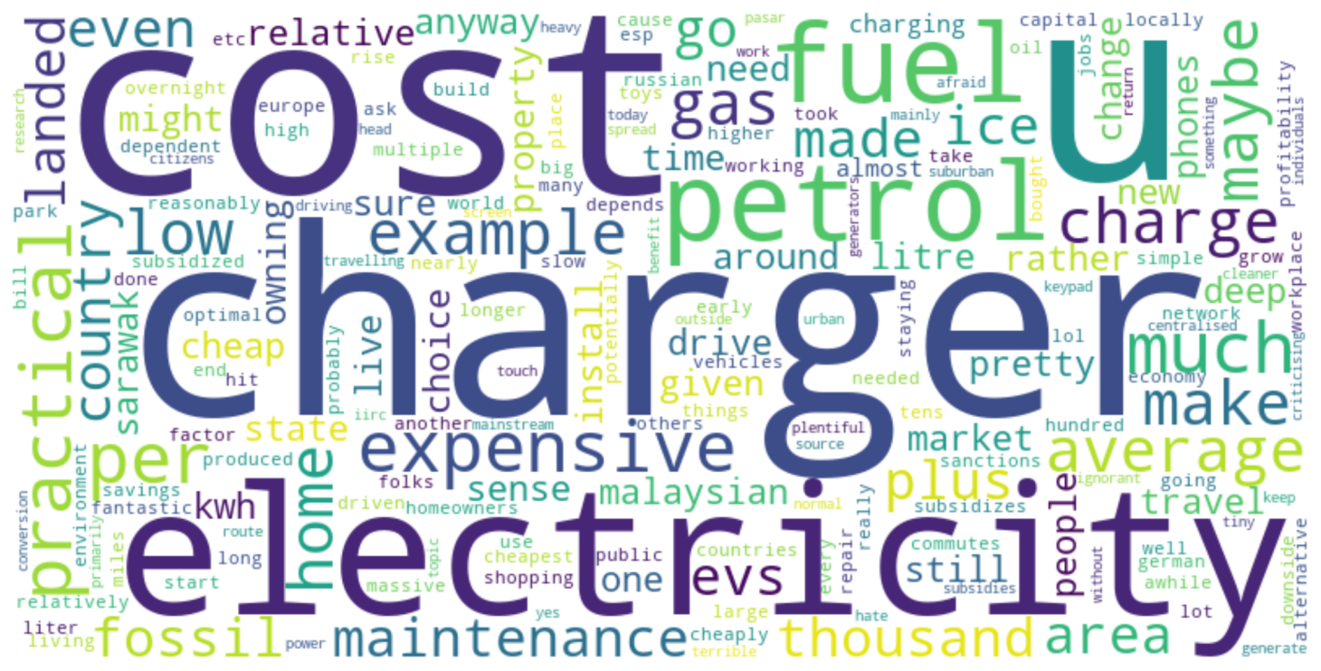
Reddit thread 1: “Are EV cars practical in Malaysia?” (128 comments)
Notes:
Keywords: Charger, cost, electricity, fuel, petrol

Slide 18
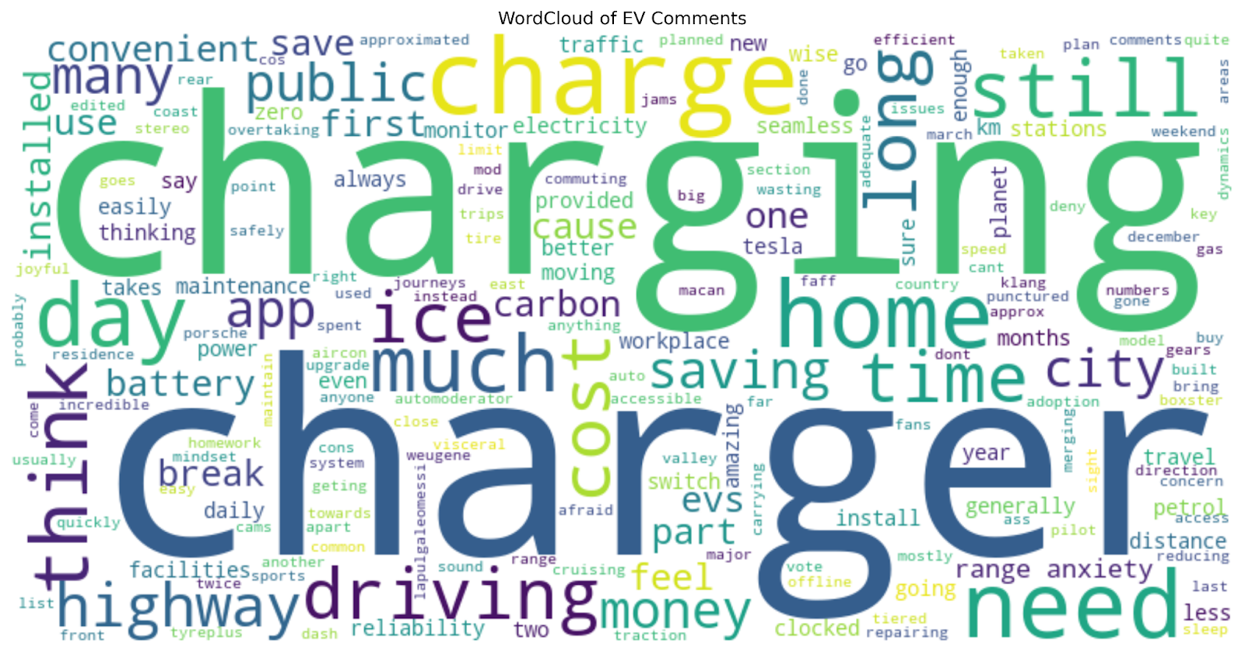
Reddit thread 2: “EV owners, what are your thoughts after using them after few years?” (21 comments)
Notes:
Keywords: Charger, charging, charge, home, time, cost

Slide 19
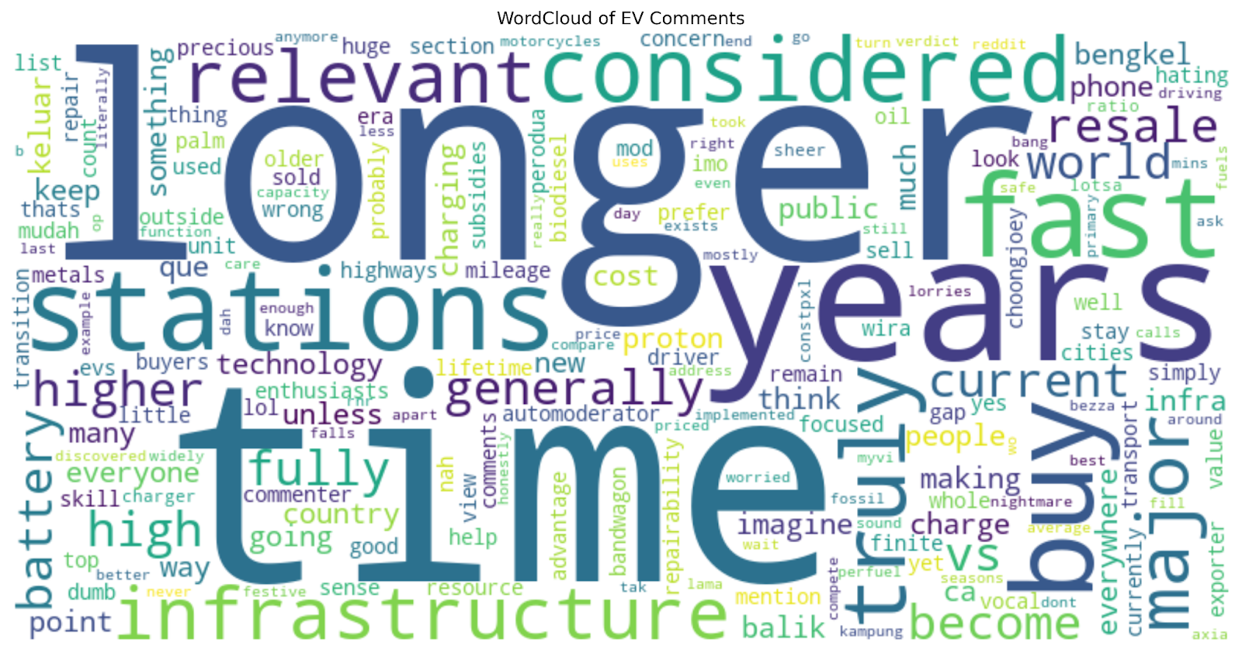
Reddit thread 3: “How long more will ICE cars stay relevant in Malaysia?” (59 comments)
Notes:
Keywords: Time, longer, stations, years, fast, battery

Slide 20
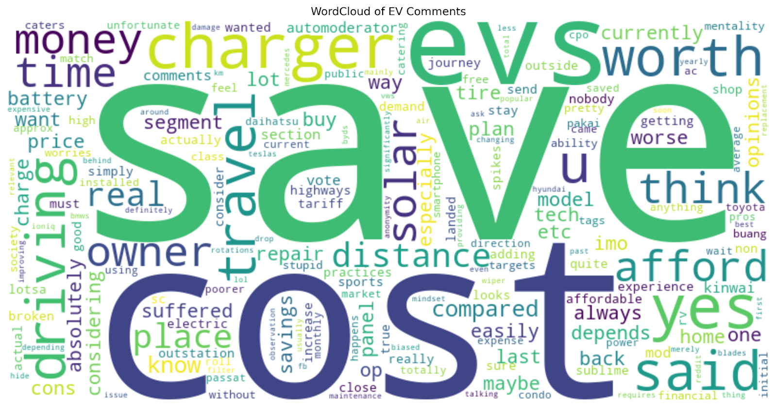
Reddit thread 4: “EV worth it?” (36 comments)
Notes:
Keywords: Save, cost, charger

Slide 21
Discussion What do the numbers tell us?

Slide 22
EV Adoption Trends
Growing presence
SUV the most preferred vehicle category
Larger body frames, enabling the integration of higher-capacity batteries
Notes:
- Although EVs still make up a minority share of the Malaysian automotive market, their presence on the road has grown significantly in the past five years. This surge coincides with the EV-friendly policies introduced by the Malaysian government in 2022, which included full import and excise duty exemptions for fully built EVs and road tax waivers from 2022 to 2025. These incentives substantially lowered the purchase cost of EVs, making them more financially accessible and accelerating adoption.
- SUVs have emerged as the most preferred category among EV owners. This reflects a broader consumer shift toward spacious and practical vehicles that cater to family and lifestyle needs. SUVs also offer larger body frames, enabling the integration of higher-capacity batteries — a factor that enhances driving range.

Slide 23
Market Share Analysis
Chinese EV brands taking the leadership
Launch of BYD Atto 3 (Dec 2022)
Value-for-money proposition
Notes:
Chinese EV brands have risen to market leadership since their entry into Malaysia in late 2022, led by the launch of the BYD Atto 3 (Sime Motors, 2022). Their rapid success is largely due to their value-for-money proposition, offering advanced features and technology at significantly lower prices.

Slide 24
Consumer Sentiment Toward EVs
High frequency keywords in related Reddit threads: “Charger,” “charging,” “station,” and “infrastructure”
Consideration: charging availability, charging time
Low resale value of EVs
Uncertainty over battery lifespan
Potential replacement costs
Swift improvements in EV technology
Low petrol prices
Notes:
Review of online discussions — particularly four Reddit threads — revealed frequent mentions of keywords related to charging infrastructure, such as “charger,” “charging,” “station,” and “infrastructure.” This suggests that charging availability is a critical consideration for potential EV buyers, particularly for residents of high-rise buildings who cannot easily install private chargers.
Charging time is another point of consideration: fully charging an EV can take several hours, whereas refueling a petrol car typically takes under five minutes (Energi Elite, n.d.).
Another notable barrier is the perceived low resale value of EVs. Potential buyers of used EVs face uncertainty over battery lifespan and potential replacement costs, while swift improvements in EV technology can render older models obsolete more quickly, further eroding their second-hand value.
Additionally, Malaysia’s relatively low petrol prices weaken the economic incentive to switch to EVs. For comparison, petrol costs USD 2.04 per litre in Norway (the world leader in EV adoption) versus USD 0.48 per litre in Malaysia, largely due to government subsidies.

Slide 25
Strategic Distribution Partnership as a Key Ingredient to Chinese EV Brands’ Success
BYD: Partnership with Sime Darby Motors
Jaecoo: 45 dealers serving both sales and after-sales support
Notes:
BYD’s combination of premium build quality, competitive pricing, and strategic distribution partnership with Sime Darby Motors has been pivotal. Comprehensive after-sales services and attractive warranty packages have further enhanced trust among Malaysian consumers.
Jaecoo: A strong dealer network and warehouse facilities have been instrumental to its success (Aubrey, 2025). Jaecoo Malaysia works with 45 dealers for their sales and after-sales support services (Azmi, 2025). The dealerships receive strong support from the brand in delivering premium customer experience at their showrooms. Their showrooms typically feature a dedicated coffee bar, product displays and a delivery lounge.

Slide 26

Conclusion Future of EV Adoption in MY

Slide 27
Future of EV Adoption in MY
EVs accounted for 4.32% of the total car market in 2025
A sharp rise from just 0.05% in 2021—an 84-fold increase
Well-positioned to achieve the government’s target of 15% of new car sales being EVs by 2030
Continued policy support & sustained investment in charging infrastructure
Notes:
- The data indicates that Malaysia is making meaningful progress toward its EV adoption goals. EVs accounted for 4.32% of the total car market in 2025, a sharp rise from just 0.05% in 2021—an 84-fold increase, though from a modest starting point. This surge reflects growing consumer acceptance as EVs enter the mass market.
- With continued policy support and sustained investment in charging infrastructure, Malaysia is well-positioned to achieve the government’s target of 15% of new car sales being EVs by 2030.

Slide 28
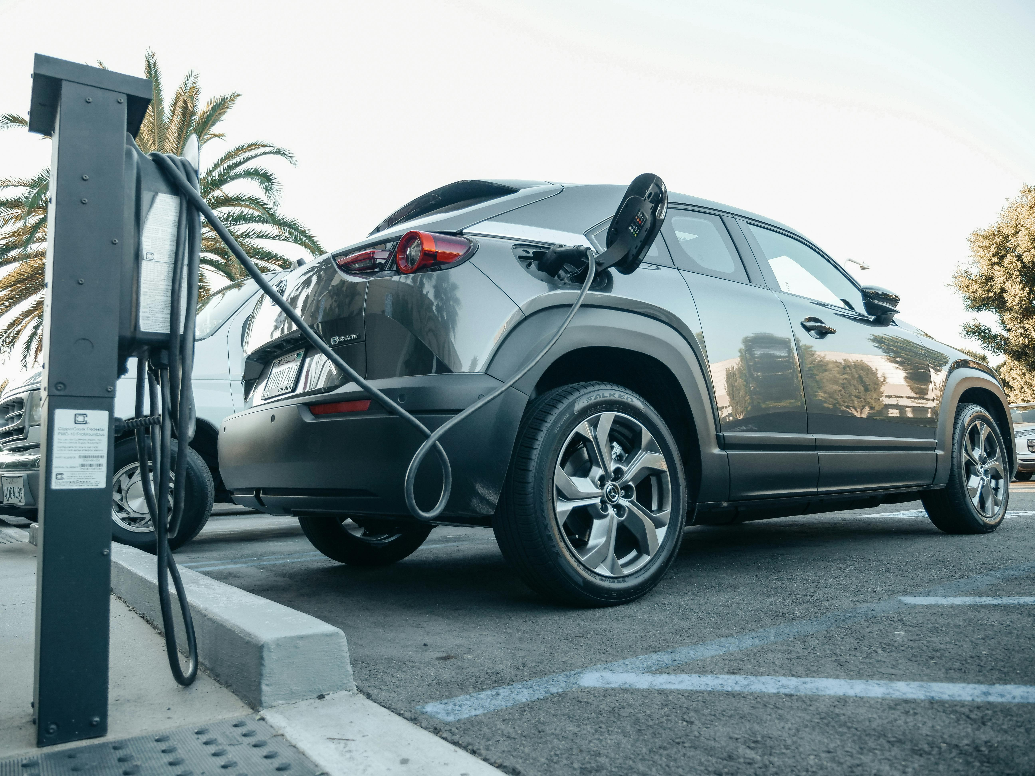
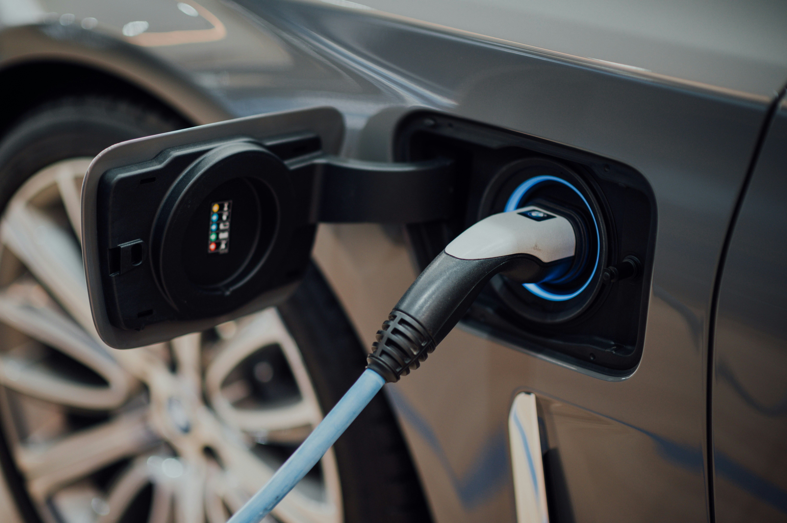
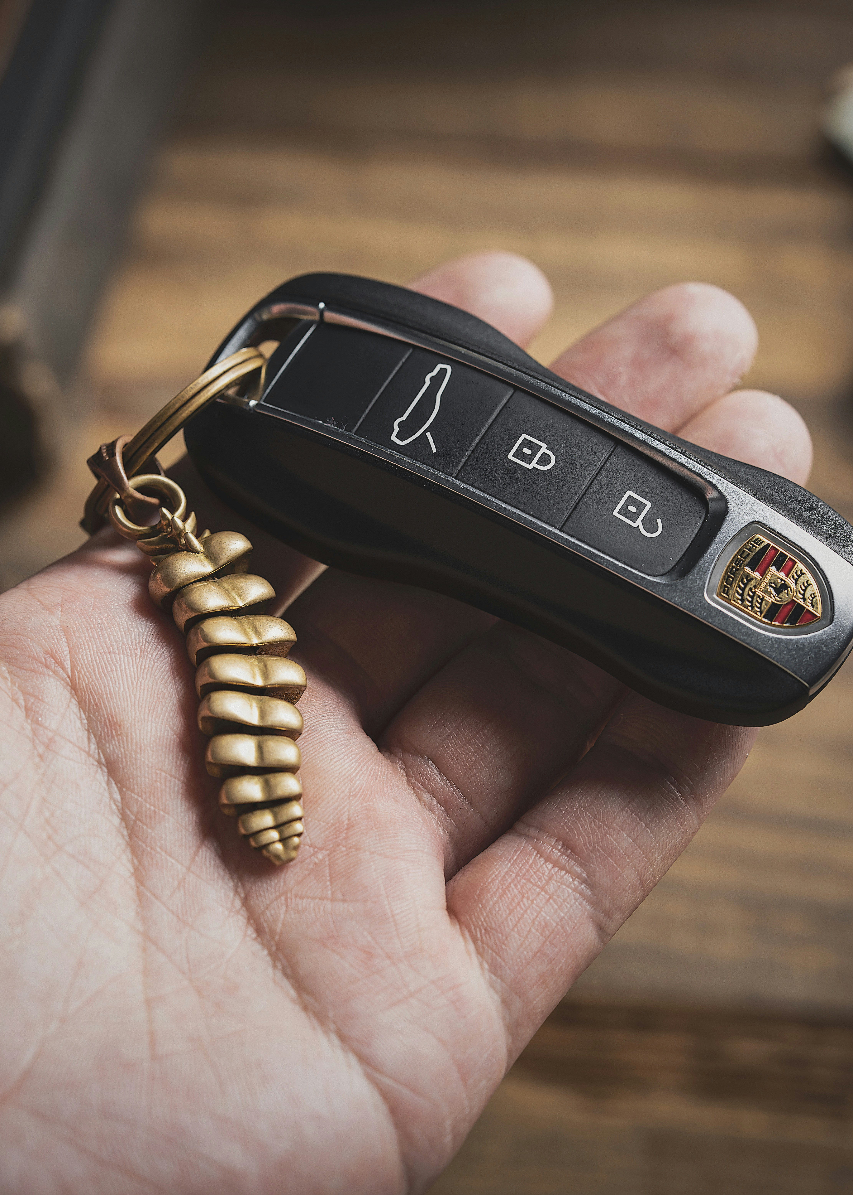
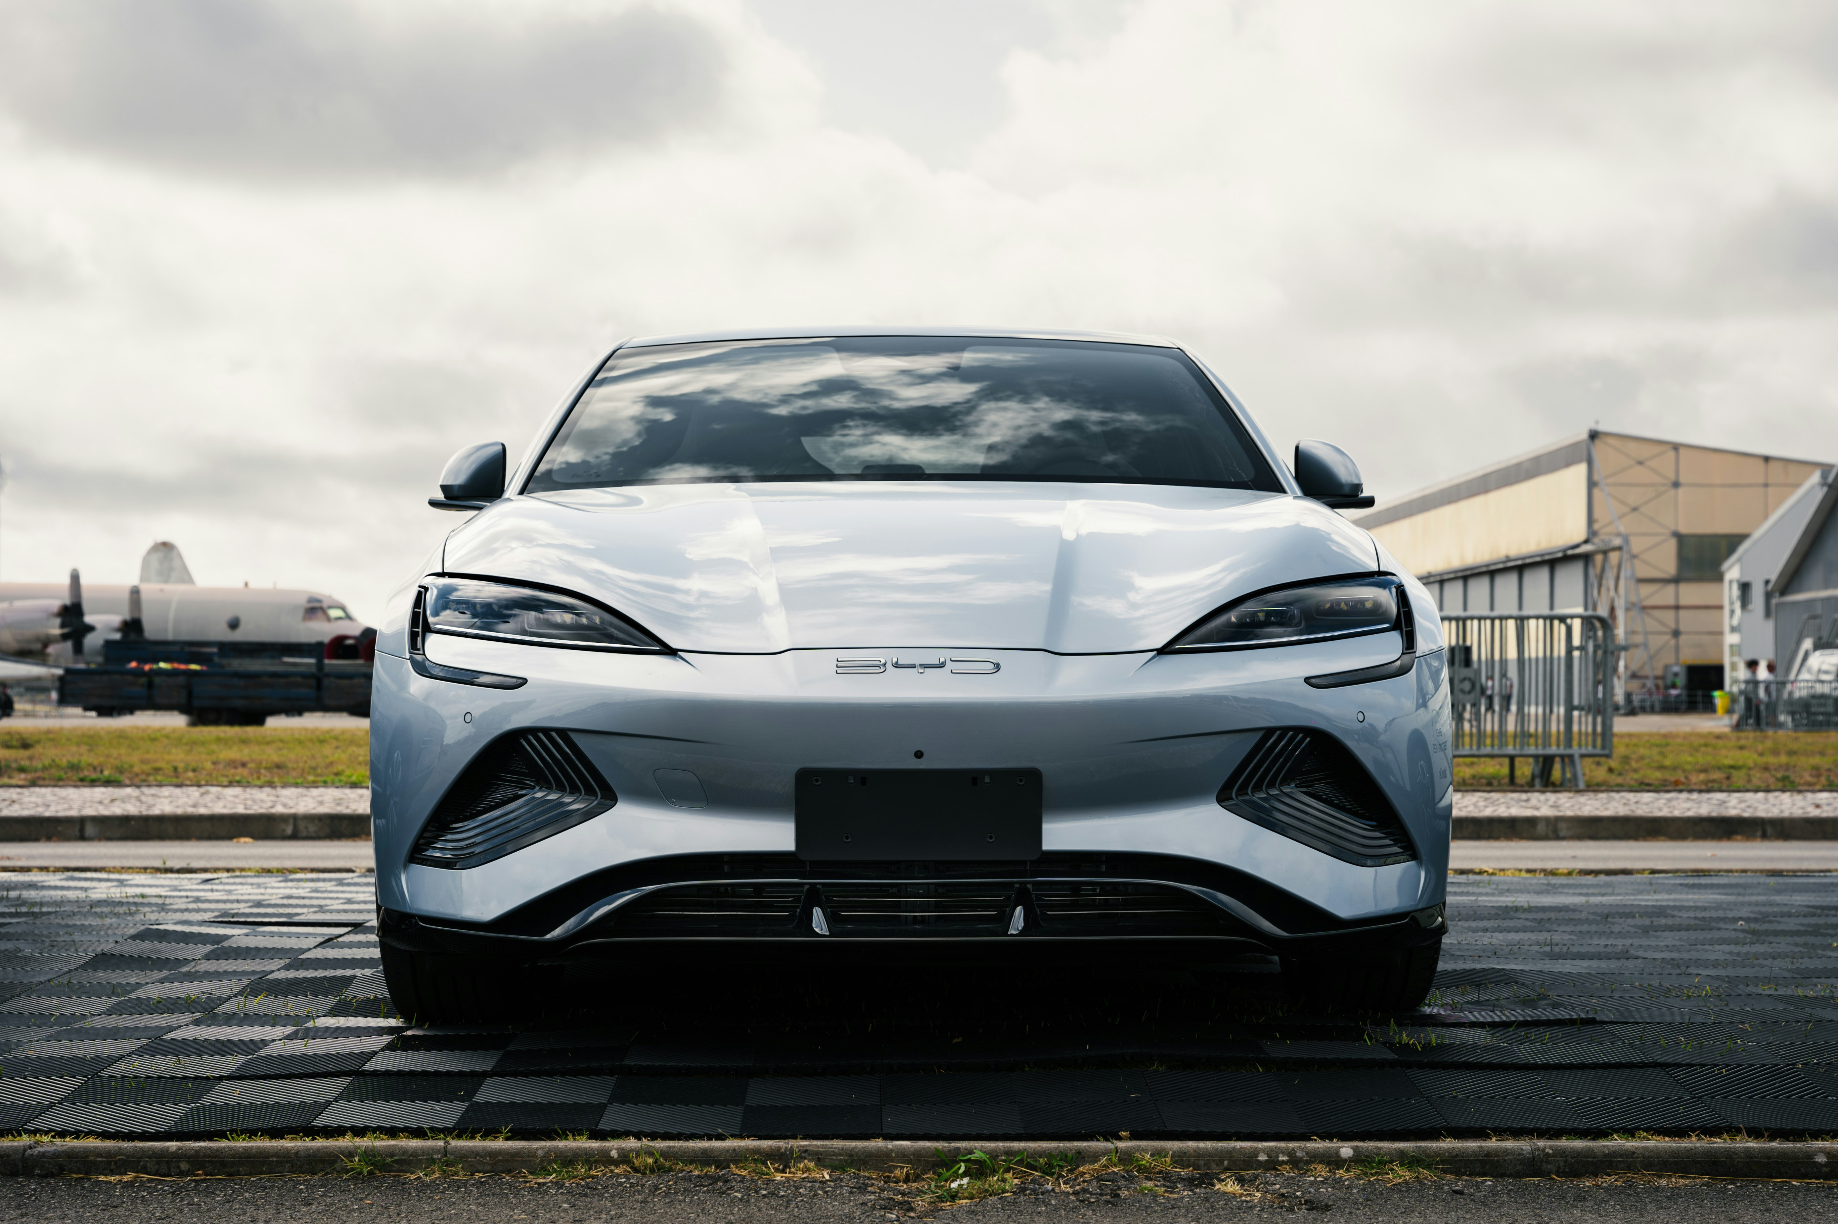
Thank you

